Slide 1
Problem Statement And Number
Student Innovation
SIH1489 .

Slide 2

Eco-savings Initiative : Your Money , Our Planet

Slide 3
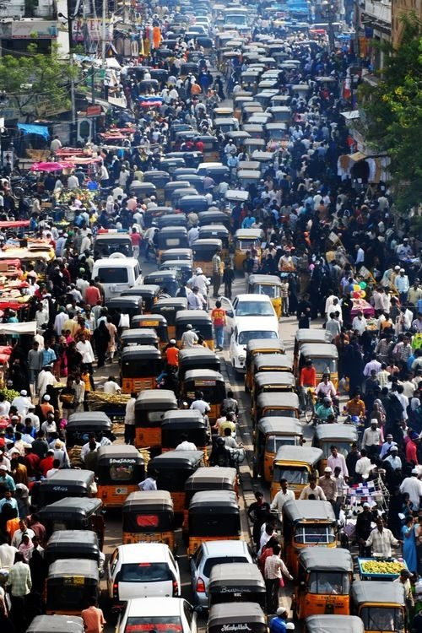
What You Understood from the problem Statement?
Problem Statement: "The problem is the inefficient utilization of personal vehicles for commuting, leading to increased traffic congestion, air pollution, and high individual transportation costs."

Slide 4
Current Existing Solutions
Existing Solutions: Ola, Uber, and Rapido offer ridesharing services but have certain
Limitations
They assign specific vehicles to each ride, leading to increased air pollution.
Their services can contribute to traffic congestion.
Costs can be relatively high compared to our proposed solution.

Slide 5
Our New Solution
Proposed Solution:
We aim to develop an application that facilitates direct communication between individuals with private vehicles (Person A) and those seeking rides (Person B).

Slide 6
Key benefits of our solution include:
Cost savings for both individuals
Reduced traffic congestion and lower environmental impact due to fewer vehicles on the road
User’s data security
Live tracking
Instant redemptions
Pre-booking facility
Real-time route matches
Multiple payment options
Group chat and calling with co-rider

Slide 7
Phase wise work Execuation
Planning
Development
Implementation
Testing

Slide 8
Planning
Define the features and functionality of the app or website.
Step 1: A rider creates an account
Step 2: A rider orders a ride
Step 3: A rider is matched with a driver
Step 4: The driver picks up the rider
Step 5: The driver takes the rider to the destination
Step 6: The rider pays for the ride
Step 7: The rider and driver rate each other and leave a review
Step 8: sos button: Users can use this functionality to notify friends and family about emergencies that occurred during a ride or get in touch with customer support in case of dangerous situations.

Slide 9
Development
Create a demo app or website for testing.
Simultaneously, work on the app's design.
Testing
Thoroughly test the app to identify and resolve any errors or bugs.
Implementation
Integrate the finalized design into the app or website.

Slide 10

202206100110081 / Gresi Lukhi
202206100110075 / Janvi Vachhani
202206100110130 / Dhanvi shah
202206100110214 / Shubh Patel
202206100110144 / Dhruv Akbari
202206100110120 / Roshan Goyani

Slide 11
Thank You

